Slide 1
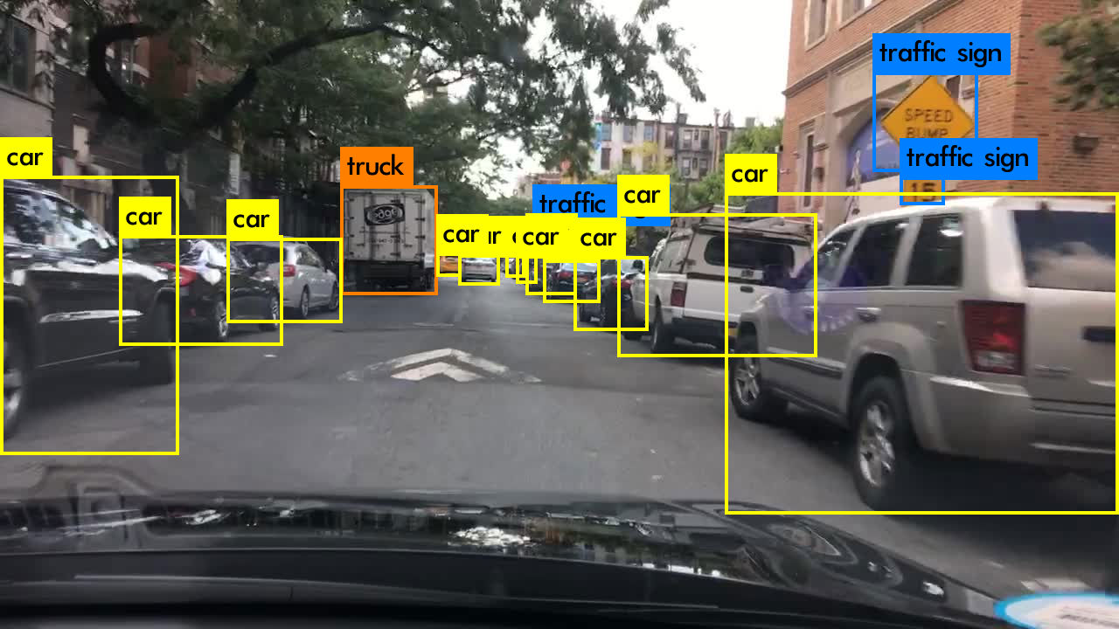
INTEL ONEAPI HACKATHON
Object Detection For Autonomous Vehicles
Optimizing the detection in vehicles

Slide 2
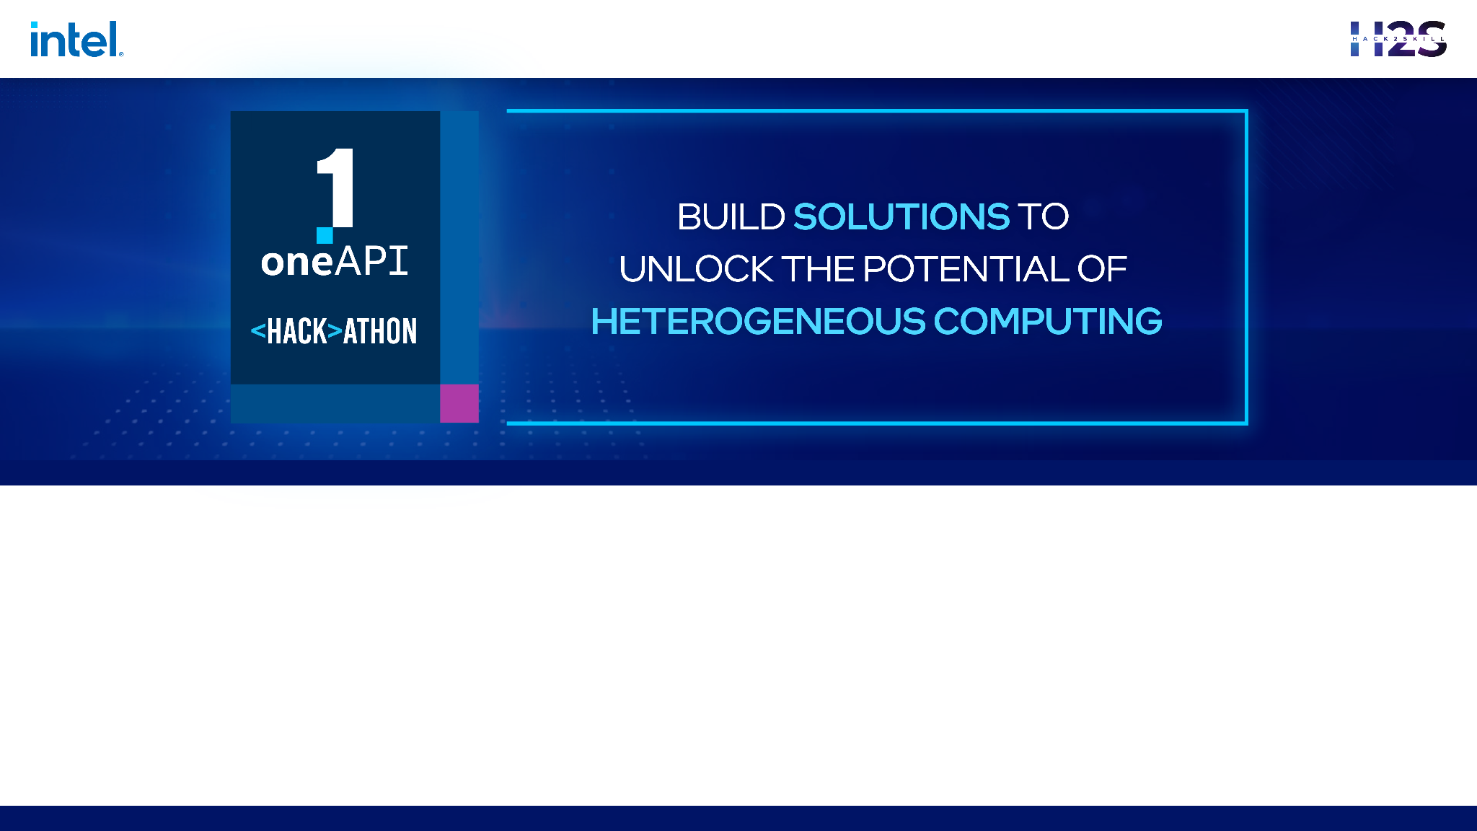
Brief about the Idea
The idea is to develop a real-time object detection model for autonomous vehicles using computer vision techniques and Intel® AI Analytics Toolkits libraries, and SYCL/DPC++ Libraries. The model should be able to accurately detect objects such as pedestrians, vehicles, trafﬁc signs, and trafﬁc signals in real-time with high accuracy and low latency.
To achieve this, the model will use advanced deep learning architectures such as YOLO, SSD, or Faster R-CNN, which use a combination of CNNs, RPNs, and NMS techniques to detect objects in an image or video stream. The model will also be optimized for performance using the Intel® AI Analytics Toolkits libraries and SYCL/DPC++ Libraries, which provide optimized deep learning primitives, hardware acceleration, and parallel computing capabilities.
The ultimate goal of this project is to improve the safety and efﬁciency of autonomous vehicles by enabling them to navigate and respond to trafﬁc in real-time. This will require testing and evaluation of the model using a separate validation dataset to measure its accuracy and latency. The model may also need to be ﬁne-tuned based on the evaluation results and repeat the training and evaluation process.
Team Name : Team Titan
Problem Statement : Object Detection For Autonomous Vehicles

Slide 3
Opportunity
Developing a real-time object detection model for autonomous vehicles using computer vision techniques and Intel® AI Analytics Toolkits libraries, and SYCL/DPC++ Libraries can help solve the problem of safe navigation in autonomous vehicles. Autonomous vehicles rely heavily on computer vision systems to detect and respond to objects in their surroundings. Accurate and timely detection of objects such as pedestrians, vehicles, traffic signs, and traffic signals is critical for the safe operation of autonomous vehicles. By developing a real-time object detection model that can accurately detect these objects with high accuracy and low latency, we can significantly improve the safety and efficiency of autonomous vehicles. The model will enable autonomous vehicles to navigate and respond to traffic in real-time, reducing the risk of accidents and improving traffic flow. Moreover, using the Intel® AI Analytics Toolkits libraries and SYCL/DPC++ Libraries for performance optimization will enable the model to run efficiently on hardware such as GPUs, FPGAs, and CPUs, which are commonly used in autonomous vehicle systems. This will ensure that the model can process large amounts of data in real-time, even under challenging conditions such as low light and adverse weather. Overall, developing a real-time object detection model for autonomous vehicles using computer vision techniques and Intel® AI Analytics Toolkits libraries, and SYCL/DPC++ Libraries can help solve the problem of safe navigation in autonomous vehicles, making our roads safer and more efficient.

Slide 4
The idea of developing a real-time object detection model for autonomous vehicles using computer vision techniques and Intel® AI Analytics Toolkits libraries, and SYCL/DPC++ Libraries is not entirely new. Object detection models for autonomous vehicles are actively being researched and developed by many companies and organizations worldwide.
However, what makes this idea unique is the focus on optimizing the performance of the model using the Intel® AI Analytics Toolkits libraries and SYCL/DPC++ Libraries. These libraries provide hardware acceleration and parallel computing capabilities, which can significantly improve the performance of the model on various hardware architectures, including CPUs, GPUs, and FPGAs.
The integration of these libraries into the object detection pipeline can lead to faster and more accurate object detection, enabling autonomous vehicles to navigate and respond to traffic in real-time. Additionally, the use of deep learning architectures such as YOLO, SSD, or Faster R-CNN, which are known for their high accuracy and low latency, can further improve the performance of the model.
Furthermore, the emphasis on real-time object detection is critical for the safety and efficiency of autonomous vehicles. With the ability to detect and respond to objects in real-time, the model can help reduce the risk of accidents and improve traffic flow, making the idea highly relevant to the field of autonomous vehicles.
In summary, while the idea of developing a real-time object detection model for autonomous vehicles is not new, the focus on performance optimization using Intel® AI Analytics Toolkits libraries and SYCL/DPC++ Libraries, along with the emphasis on real-time detection, makes it unique and highly relevant to the field of autonomous vehicles.

Slide 5
List of features offered by the solution
High accuracy and low latency: The model can accurately detect objects such as pedestrians, vehicles, traffic signs, and traffic signals with low latency, reducing the risk of accidents and improving traffic flow.
Performance optimization: The use of Intel® AI Analytics Toolkits libraries and SYCL/DPC++ Libraries can optimize the performance of the model, making it efficient and scalable across various hardware architectures.
Deep learning architecture: The model can use advanced deep learning architectures such as YOLO, SSD, or Faster R-CNN, which are known for their high accuracy and low latency, to improve the accuracy and speed of object detection.
Adaptability to different environments: The model can adapt to different environmental conditions, such as low light and adverse weather, enabling it to perform reliably under various conditions.
Compatibility with autonomous vehicle systems: The model can integrate seamlessly with autonomous vehicle systems, enabling it to communicate with other systems and make decisions based on the detected objects.
Evaluation and testing: The model can be evaluated and tested using a separate validation dataset, ensuring that it meets the required accuracy and latency thresholds for safe navigation.

Slide 6
List of oneAPI Ai Analytics Toolkits, its libraries and the SYCL/DPC++ Libraries used
Intel® Distribution of OpenVINO™ Toolkit: A toolkit that provides optimized pre-trained models and inference engines for computer vision applications.
Intel® Math Kernel Library (Intel® MKL): A library that provides optimized mathematical functions for deep learning and machine learning workloads.
Intel® VTune™ Profiler: A performance profiling tool that can be used to optimize the performance of the model and identify bottlenecks.
Intel® oneAPI Threading Building Blocks (oneTBB): A library that provides a high-level abstraction for parallel programming, making it easier to parallelize the object detection pipeline.
Intel® Optimization for TensorFlow

Slide 7
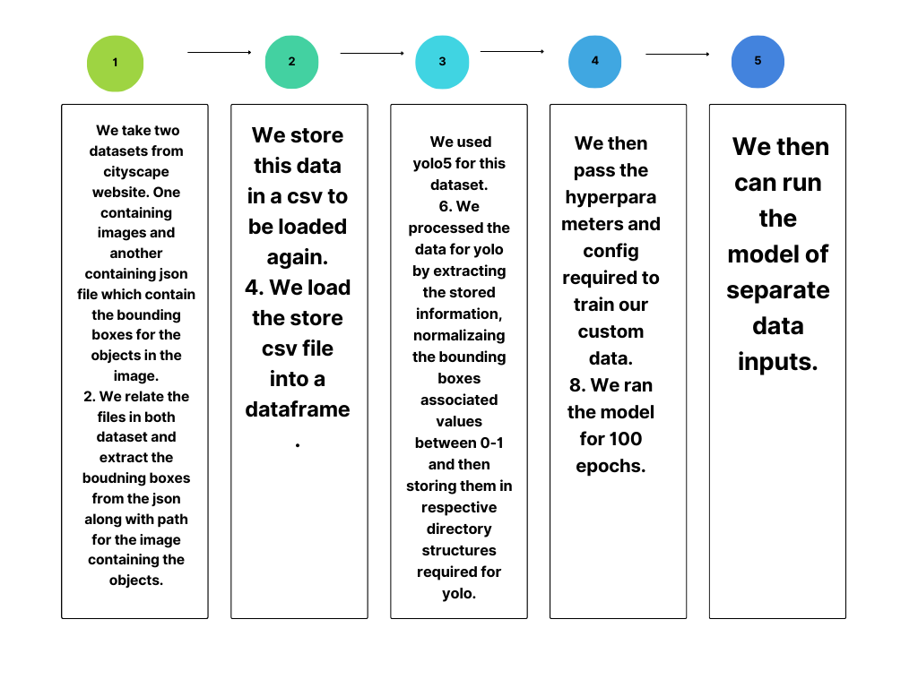
Process Flow Diagram

Slide 8
Technologies used
Deep Learning Frameworks: TensorFlow, PyTorch, and Caffe
Libraries: OpenCV, NumPy, and SciPy

Slide 9
Estimated cost of/after implementing the solution
The estimated cost of implementing the solution would depend on several factors, including the scale of implementation, the number of students, the hardware and software infrastructure requirements, and the level of customization required. However, the use of the Intel® AI Analytics Toolkits, its libraries, and SYCL/DPC++ Libraries can significantly reduce the cost of development and deployment by providing a scalable and efficient solution. Additionally, the benefits of improved student retention rates and equitable access to quality education can result in long-term cost savings and socio-economic benefits for society as a whole.

